Slide 1

Customer Churn Prediction for a Telecommunications Company
Project Proposal Presentation

Slide 2
Motivation of the Project
As a team, we realized that many companies focus heavily on controlling customer churn.
Frederick Reichheld, who invented the Net Promoter Score (NPS), found that a 5% increase in customer retention can boost profits by 25% to 95%.
Churn analysis goes beyond predictions—it's about building strategies to retain customers and grow revenue.
Churn analysis helps measure retention and identify potential issues early, allowing them to address problems before customers leave.
Predicting churn allows businesses to implement proactive, targeted retention strategies.

Slide 3
About Data
Data is sourced from IBM #Cognos Analytics Sample Data
The dataset includes information on 7,042 customers, with 30 variables encompassing demographics, service details, billing information, and churn status.
Key features include
Customer demographics
Service details
Contract and billing details
Churn indicator

Slide 4
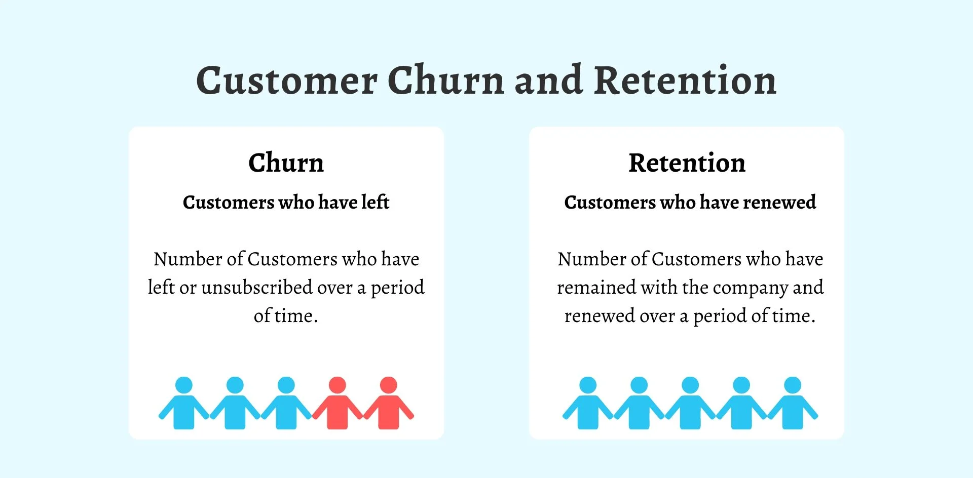
What Is Customer Churn and Retention?

Slide 5
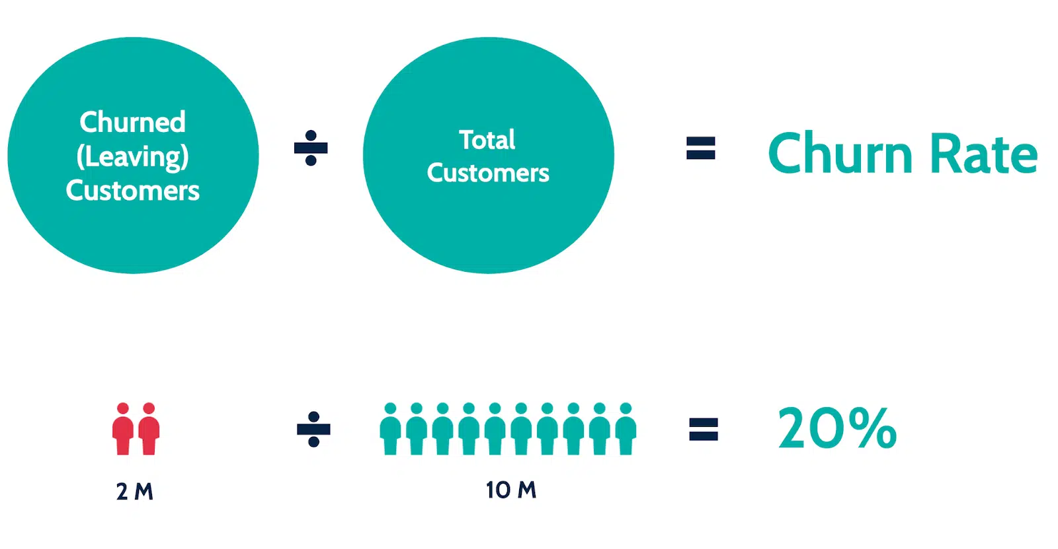
How is Customer Churn Rate Calculated?

Slide 6
Research Questions?
Do customers using more services (e.g., phone, internet, streaming) have lower churn rates?
How does contract type (e.g., month-to-month vs. long-term) influence churn?
Do customers using paperless billing or specific payment methods (e.g., electronic check, credit card) churn more frequently?
Does referring a friend reduce the likelihood of churn?
What are the most common reasons for customer churn?
Do higher monthly or total charges increase the likelihood of churn?
How does the sentiment expressed in customer feedback (e.g., churn reasons) correlate with churn likelihood?
Can deep learning models capture complex, non-linear relationships between customer behaviours and churn likelihood more effectively than traditional models?

Slide 7
Methodology
Group-by Analysis: To compare churn rates across services, contract types, payment methods, and referral status.
Visualization: Bar charts, box plots, and heatmaps to visualize churn across customer segments.
Chi-Square Tests: To assess the relationship between categorical variables (e.g., contract type, payment method) and churn.
Machine Learning models:
Logistic Regression - to predict churn probability and quantify the impact of factors like contract type, monthly charges, and referrals.
Decision Trees - to capture non-linear relationships
Random Forest - for robustness and reducing overfitting.
Gradient Boosting - for highly accurate predictions.
Correlation Analysis: To explore the relationship between charges and churn.

Slide 8
Methodology
Deep Learning Models:
Neural Networks (using TensorFlow/Keras): To capture more complex, non-linear relationships between customer data, including sentiment and service usage, to improve churn predictions.
Sentiment Analysis:
VADER and TextBlob: To analyse customer feedback and categorize churn reasons into Positive, Neutral, and Negative sentiment. The analysis will explore the correlation between sentiment and churn behaviour, adding emotional insights to the churn prediction.
Frequency Analysis: To identify the most common reasons for customer churn.

Slide 9
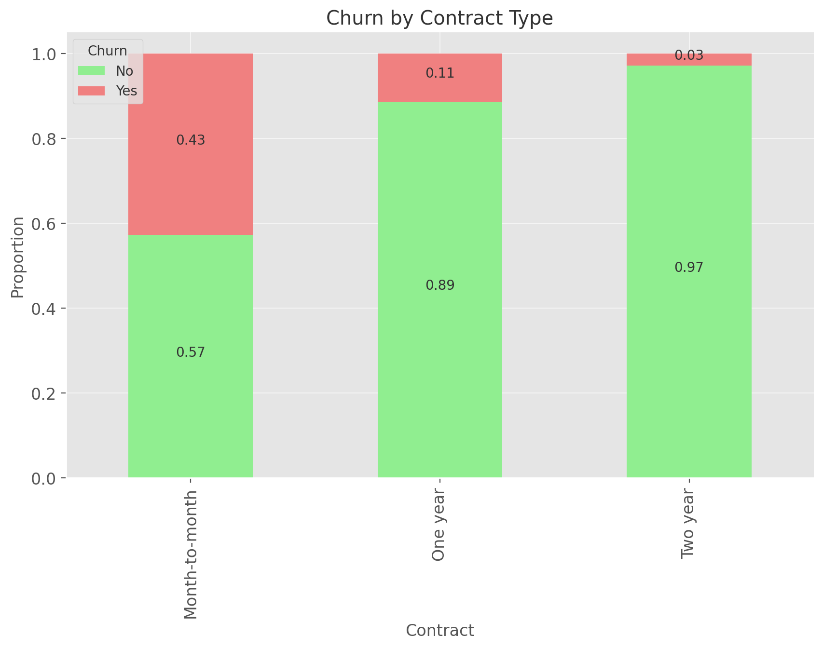
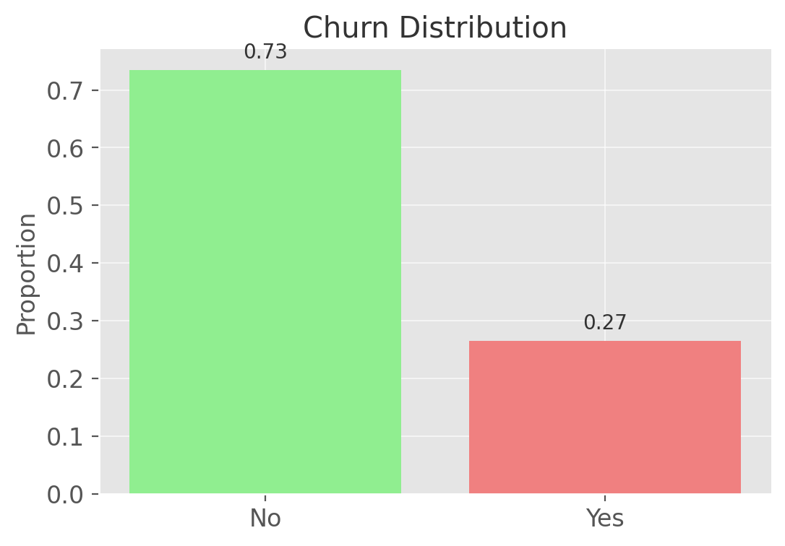
Preliminary Results
Missing Data: There are no missing values in any of the columns.
Churn Distribution: 73.5% of customers did not churn, while 26.5% of customers churned.
Churn by Contract Type: 42.7% of customers with month-to-month contracts churned, 11.3% with one-year contracts churned, and only 2.8% with two-year contracts churned.

Slide 10
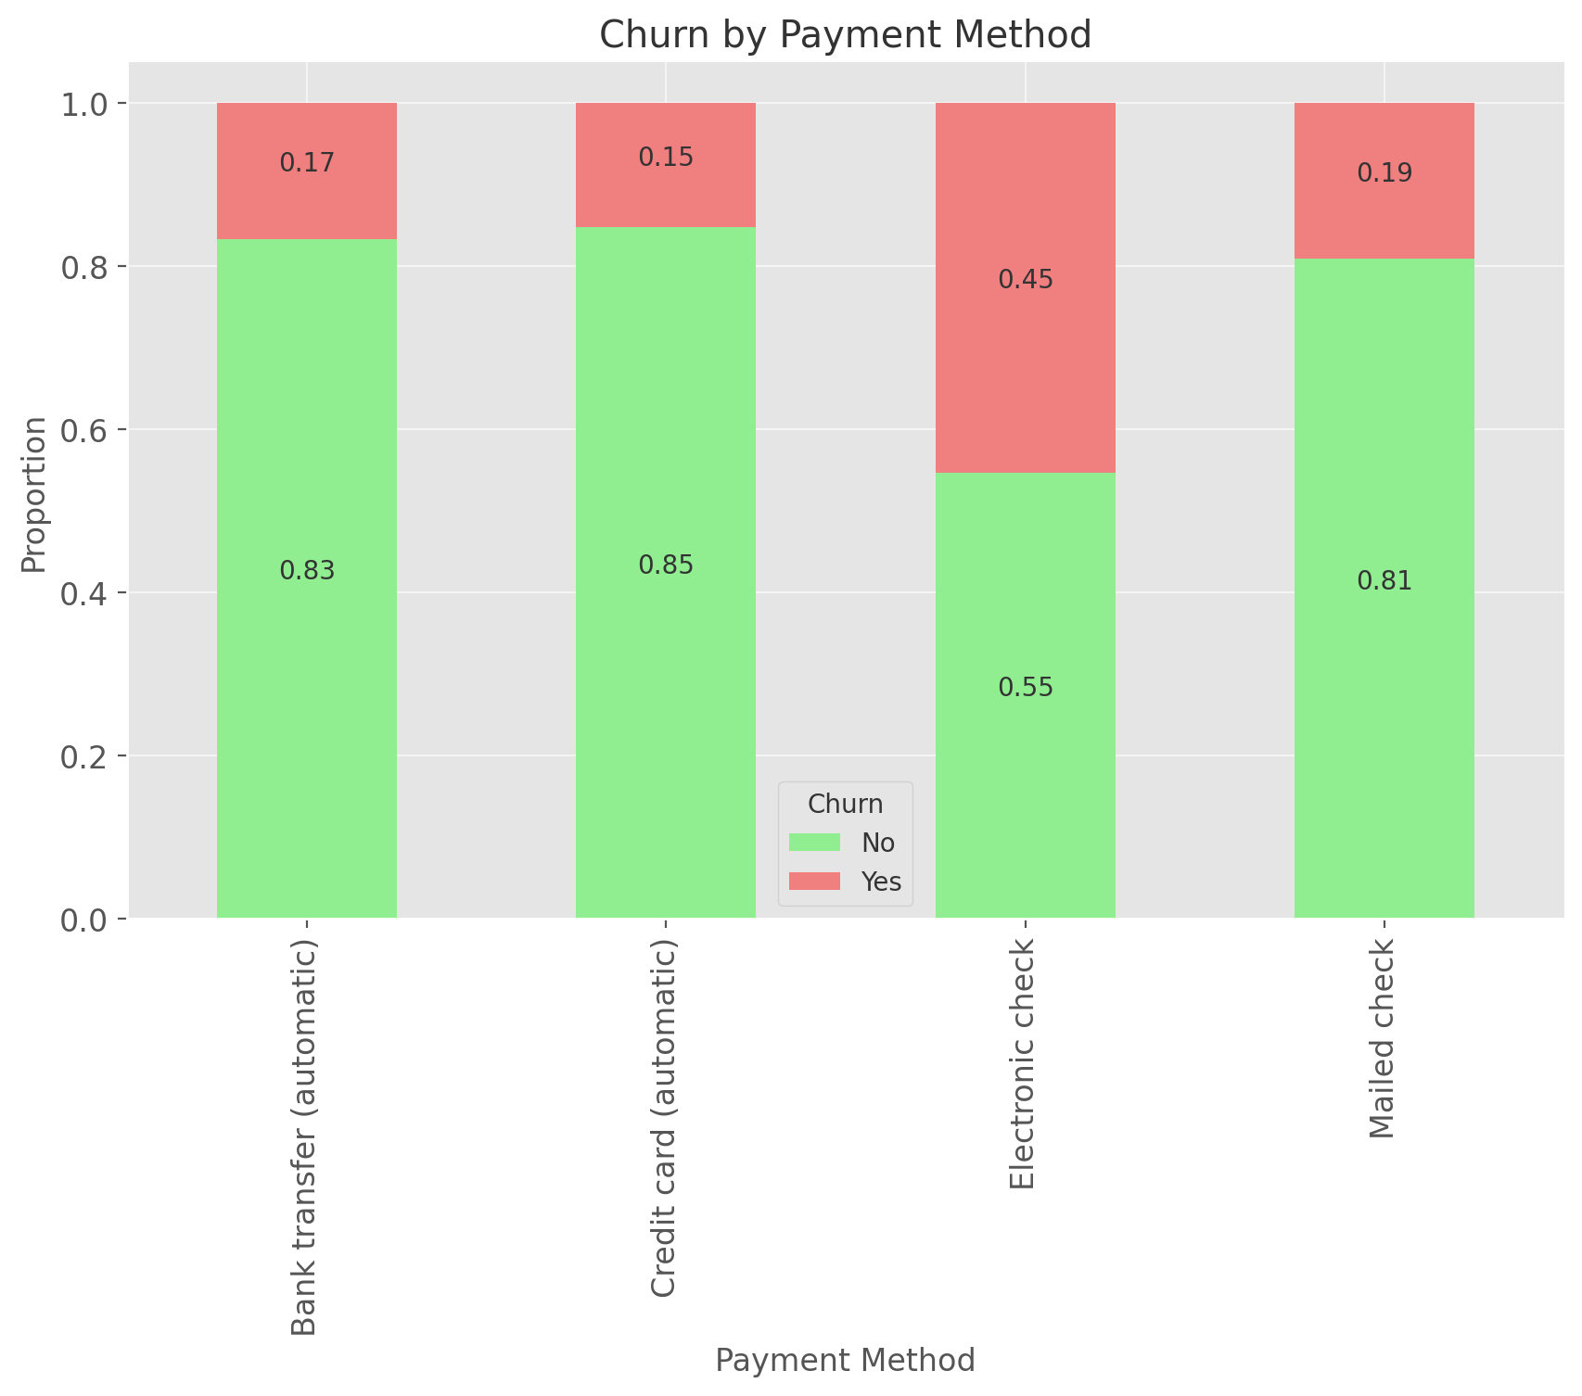
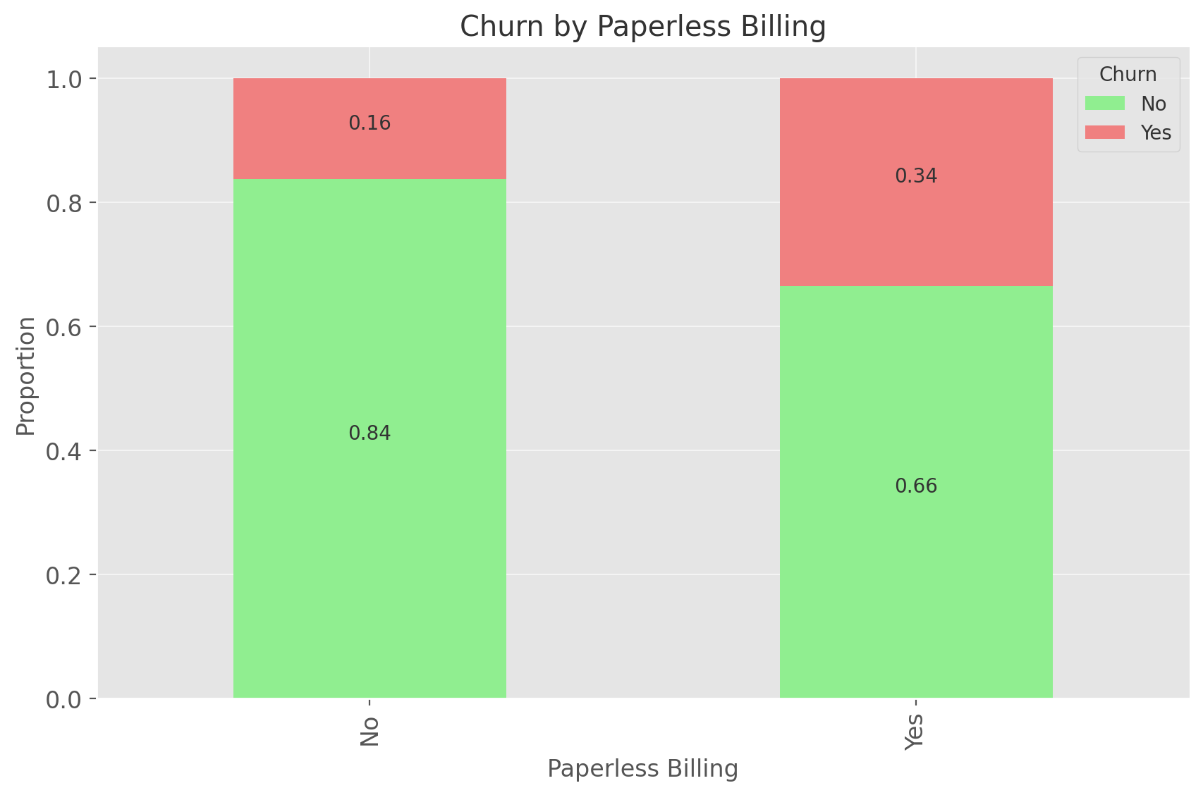
Preliminary Results
Churn by Payment Method: 45.3% of customers paying via electronic check churned, the highest among all methods, while bank transfer, credit card, and mailed check methods had significantly lower churn rates around 15-20%.
Churn by Paperless Billing: Customers using paperless billing had a higher churn rate (33.6%) compared to those not using paperless billing (16.3%).

Slide 11
Expected Outcomes
Long-term contracts and automatic payment methods will continue to show lower churn rates.
Higher monthly charges and electronic check payments will remain key factors contributing to higher churn.
Analyzing additional services used (e.g., phone, internet, streaming) may show an inverse relationship with churn, as more engaged customers may be less likely to churn.
Sentiment Analysis is expected to identify emotional factors driving churn, such as negative sentiments in "Price too high" or "Competitor made better offer." These insights could allow more targeted retention strategies for at-risk customers.
Deep Learning models are expected to enhance churn prediction accuracy by capturing complex, non-linear relationships between customer behaviours, sentiment, and churn, outperforming traditional models.

Slide 12
Expected Contributions & Implications
Improved Churn Prediction: By testing and comparing multiple machine learning models, we will develop an accurate model to predict customers at risk of churning, enabling proactive retention efforts.
Actionable Insights: The analysis will identify the key drivers of churn, such as contract type, service usage, billing methods, and pricing, allowing for targeted interventions to reduce churn.
Retention Strategy Design: Insights into the impact of referrals, service bundling, payment methods and customer sentiment will guide the development of personalized retention strategies to keep high-risk customers engaged.
Using Chi-Square Tests, we can identify statistically significant relationships between factors like contract type, payment method, sentiment categories, and churn.
Segmentation Insights: Using Group-by Analysis, the project will highlight churn rates across various customer segments(e.g., services used, contract type, and payment method, sentiment), providing clear direction on which customer groups to target with retention efforts.

Slide 13
References
Gallo, A. (2014, November 5). The Value of Keeping the Right Customers. Harvard Business Review. https://hbr.org/2014/10/the-value-of-keeping-the-right-customers
Churn Analysis: How to calculate, identify & reduce churn. (n.d.). https://www.dock.us/library/churn-analysis
Guide to IBM #Cognos Analytics Sample Data. (2023, March 3). Higher Logic, LLC. https://community.ibm.com/community/user/businessanalytics/participate/blogs/blogviewer?BlogKey=FF811D76-ABE0-4DF2-BCEA-917176FD72E4
Ughade, N. (2024, June 25). Churn Analysis: Different Steps To Understanding Why Customers Leave. Chargebee. https://www.chargebee.com/blog/churn-analysis/
Nesterick, E., & Nesterick, E. (2024, March 15). Churn analysis: 3 approaches for getting to the bottom of churn. ChurnZero. https://churnzero.com/blog/churn-analysis/

Slide 14
Thank you
Open for Questions…!!

